Slide 1
MAC Protocols for WSN

Slide 2
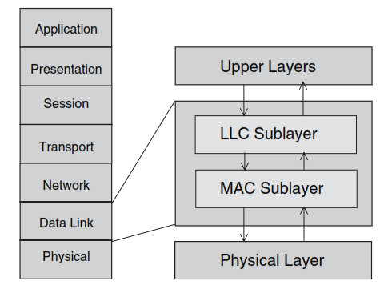
OSI Model and DLL Architecture

Slide 3
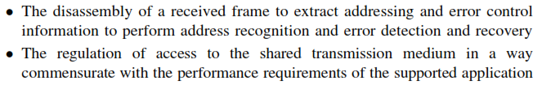
Functions of DLL
Factors influencing behaviour of Multiple-Access Protocol
Intelligence of Decision
Overhead involved
Nature of Information
Pre-determined – Information known to all communicating nodes
Dynamic Global – Acquired by all nodes during protocol operation
Dynamic Local – known only to individual nodes
Efficiency vs. overhead

Slide 4
Performance Requirements
Delay
Refers to the amount of time spent by a data packet in the MAC layer before it is transmitted successfully.
Depends not only on the network trafﬁc load, but also on the design choices of the MAC protocol.
Types :
Probabilistic delay guarantee – expected value, variance, confidence interval
Deterministic delay guarantee - – upper bound for access time
Throughput
Deﬁned as the rate at which messages are serviced by a communication system.
Measured in messages per second or bits per second
Represents the fraction of the channel capacity used for data transmission.
Throughput increases as the load on the communication system increases initially. After the load reaches a certain threshold, the throughput ceases to increase, and in some cases, it may start to decrease.
Objective of a MAC protocol is to maximize the channel throughput while minimizing message delay

Slide 5
Performance Requirements
Robustness
Deﬁned as a combination of reliability, availability, and dependability requirements
Reﬂects the degree of the protocol insensitivity to errors and misinformation
Addresses issues such as error conﬁnement, error detection and masking, reconﬁguration, and restart.
Achieving robustness in WSN is difﬁcult, as it depends strongly on the failure models of both the links and the communicating nodes.

Slide 6
Performance Requirements
Scalability
Refers to the ability of a communications system to meet its performance characteristics regardless of the size of the network or the number of competing nodes.
To support scalability the protocol should
Avoid relying on globally consistent network states.
Localize interactions among the communicating nodes, through the development of hierarchical structures
Use information aggregation strategies.
Eg. Grouping sensor nodes into clusters

Slide 7
Performance Requirements
Stability
Refers to the ability of a communications system to handle ﬂuctuations of the trafﬁc load over sustained periods of time.
A stable MAC protocol must be able to handle instantaneous loads which exceed the maximum sustained load as long as the long-term load offered does not exceed the maximum capacity of the channel.
With respect to delay, a MAC protocol is considered to be stable, if the message waiting time is bounded.
Characterized by a bounded backlog of messages in the transmission queue
With respect to throughput, a MAC protocol is stable if the throughput does not collapse as the load offered increases.

Slide 8
Performance Requirements
Fairness
Allocating channel capacity evenly among the competing communicating nodes without unduly reducing the network throughput.
Required for achieving equitable QoS to all
no application is starved or penalized excessively.
In heterogeneous resource demands, communicating nodes are assigned different weights to reﬂect their relative resource share and proportional fairness should be achieved based on the weights assigned.

Slide 9
Performance Requirements
Energy Efﬁciency
Sensor nodes have limited processing capability, short-range radio communication ability, batteries with small capacity and deployed in unattended environments, making it difﬁcult to change their batteries.
Recharging sensor batteries by energy scavenging is complicated and volatile. So energy conservation becomes of paramount importance in WSNs to prolong the lifetime of sensor nodes.
To reduce power consumption
Use low-power Electronics
Design energy-aware communication protocols
Sources of Energy-waste
Collision
Idle listening
Overhearing
Control Packet Overhead
Frequent switching between operation modes

Slide 10
Classification of MAC Protocols
Fixed Assignment
Each node is allocated a predetermined fixed amount of channel resources exclusively
No Collision
Eg. FDMA, TDMA, CDMA [DSSS, FHSS}
Demand Assignment
Channel is allocated to the node selected for a speciﬁed amount of time
Requires a network control mechanism for arbitration
Control channel required for sending channel requests
Delay due to request/grant mechanism
Centralized control – Polling
All nodes can receive equal access to medium
Overhead due to control messages
Distributed control – Token-based and Reservation-based
Reservation mini-slots followed by data transmission slots
Random Assignment
All communicating nodes contend for the medium and whoever wins will get the medium
Eg. ALOHA, CSMA/CD, CSMA/CA

Slide 11
FDMA
FDMA was the initial multiple-access technique for cellular systems
Separates large band into smaller channels.
Each channel has the ability to support user.
Guard bands are used to separate channel preventing co-channel interference
Narrow bandwidth (30 khz).
Code
User 4
User 3
User 2
User 1
Time
Frequency

Slide 12
FDMA
Advantages
Simple to implement in terms of hardware.
Fairly efficient with a small base population and with constant traffic.
Disadvantages
Network and spectrum planning are intensive and time consuming.
Channels are dedicated for a single user, idle channels add spectrum inefficiency.

Slide 13
Time Division Multiple Access (TDMA)
Radio spectrum is divided into time slots and are allocated for each user to transmit and receive information.
Information is transferred and received in form of frame. A frame consists of a preamble, an information message and trial bits.
Preamble contains the address and synchronization information of sender and receiver to identify each other. Trial bits contain framing information.

Slide 14
TDMA
Entire bandwidth is available to the user for finite period of time.
Users are allotted time slots for a channel allowing sharing of a single channel.
Requires time synchronization.
Each of the user takes turn in transmitting and receiving data in a round robin fashion.
Code
User 3
User 4
User 1
User 2
Time
Frequency
Notes:
As frequency spectrum experiences more traffic, spectrum efficiency becomes more important.
In digital systems, continuous transmission is not required because users do not use the allotted bandwidth all the time. In such systems,
TDMA is a complimentary access technique to FDMA. Global Systems for Mobile communications (GSM) uses the TDMA technique.

Slide 15
TDMA Advantages & Disadvantages
Advantages
Extended battery life and talk time
More efficient use of spectrum, compared to FDMA
Will accommodate more users in the same spectrum space than an FDMA system
Disadvantages
Network and spectrum planning are intensive
Multipath interference affects call quality
Dropped calls are possible when users switch in and out of different cells.
Too few users result in idle channels (rural versus urban environment)
Higher costs due to greater equipment

Slide 16
Code Division Multiple Access (CDMA)
All users transmit information simultaneously by using the same carrier frequency with their own code word, which is orthogonal to other users. To detect the message, the receiver should know the code word used by the transmitter.

Slide 17
CDMA
CDMA is a spread spectrum technique used to increase spectrum efficiency.
SS has been used in military applications due to anti-jamming and security.
Code
User 4
User 4
User 3
User 2
User 1
Time
Frequency

Slide 18
CDMA
Advantages
Greatest spectrum efficiency:
Improves quality by filtering out background noise, cross-talk, and interference
Simplified frequency planning - all users on a CDMA system use the same radio frequency spectrum.
Random Walsh codes enhance user privacy; a spread-spectrum advantage
Precise power control increases life time by reducing power consumption
Disadvantages
Backwards compatibility techniques are costly
Sender and Receiver equipment is expensive
Low traffic areas lead to inefficient use of spectrum and equipment resources
Notes:
capacity increases of 8 to 10 times that of an analog system and 4 to 5 times that of other digital systems which makes it most useful in high traffic areas with a large number of users and limited spectrum

Slide 19
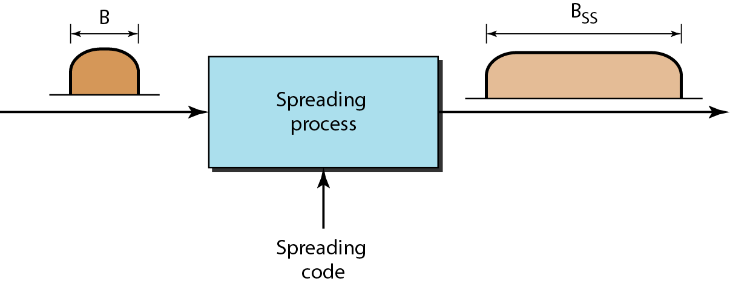
Spread Spectrum
After the signal is created by the source, the spreading process uses a spreading code and spreads the bandwidth.
The spreading code is a series of numbers that look random, but are actually a pattern.

Slide 20
Spread Spectrum
Types of spreading:
direct sequence spread spectrum (DSSS)
frequency hopping spread spectrum (FHSS)

Slide 21
Frequency hopping spread spectrum (FHSS)
The frequency hopping spread spectrum (FHSS) technique uses M different carrier frequencies that are modulated by the source signal.
At one moment, the signal modulates one carrier frequency; at the next moment, the signal modulates another carrier frequency.
If an intruder tries to intercept the transmitted signal, she can only
access a small piece of data because she does not know the spreading sequence to quickly adapt herself to the next hop.

Slide 22
Frequency Hoping Spread Spectrum (FHSS)
Signal is broadcast over seemingly random series of radio frequencies
A number of channels allocated for the FH signal
Width of each channel corresponds to bandwidth of input signal
Signal hops from frequency to frequency at fixed intervals
Transmitter operates in one channel at a time
Bits are transmitted using some encoding scheme
At each successive interval, a new carrier frequency is selected
Channel sequence dictated by spreading code

Slide 23
Frequency Hoping Spread Spectrum
Receiver, hopping between frequencies in synchronization with transmitter, picks up message
Advantages
Attempts to jam signal on one frequency succeed only at knocking out a few bits

Slide 24
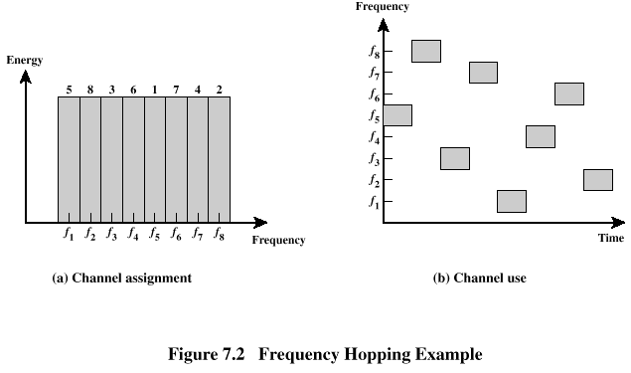
Frequency Hoping Spread Spectrum

Slide 25
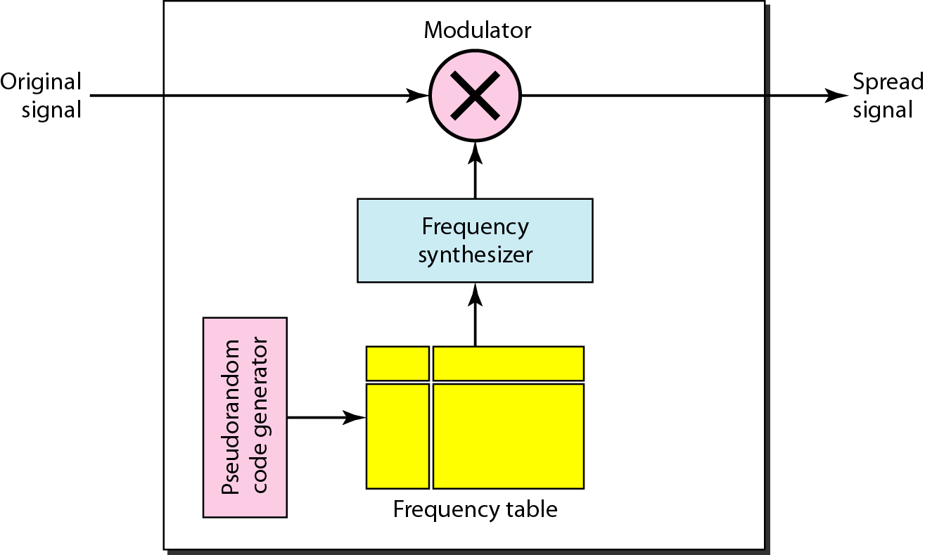
Frequency Hopping Spread Spectrum (FHSS)

Slide 26
Frequency Hopping Spread Spectrum (FHSS)
Suppose we have decided to have eight hopping frequencies. This is extremely low for real applications and is just for illustration.
In this case, Mis 8 and k is 3. The pseudorandom code generator will create eight different 3-bit patterns. These are mapped to eight different frequencies in the frequency table

Slide 27
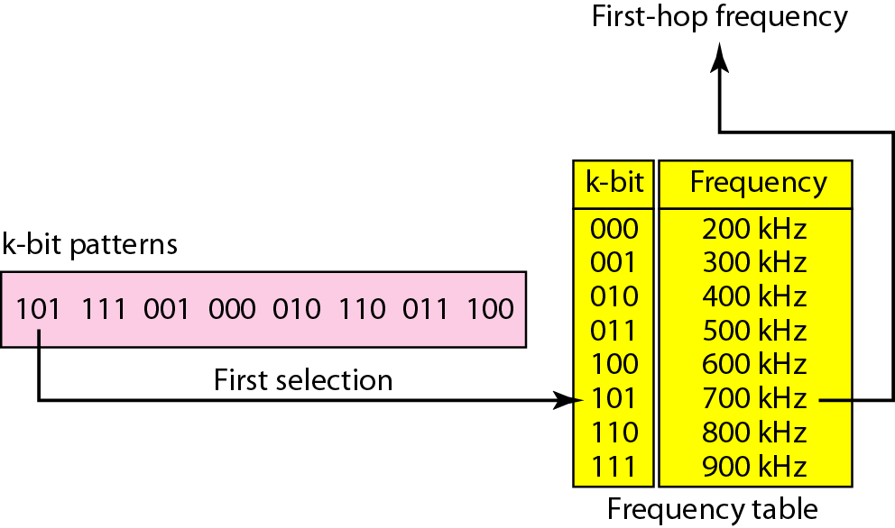
Frequency Selection in FHSS

Slide 28
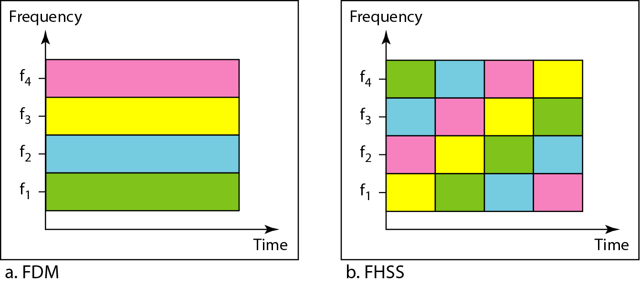
Bandwidth Sharing

Slide 29
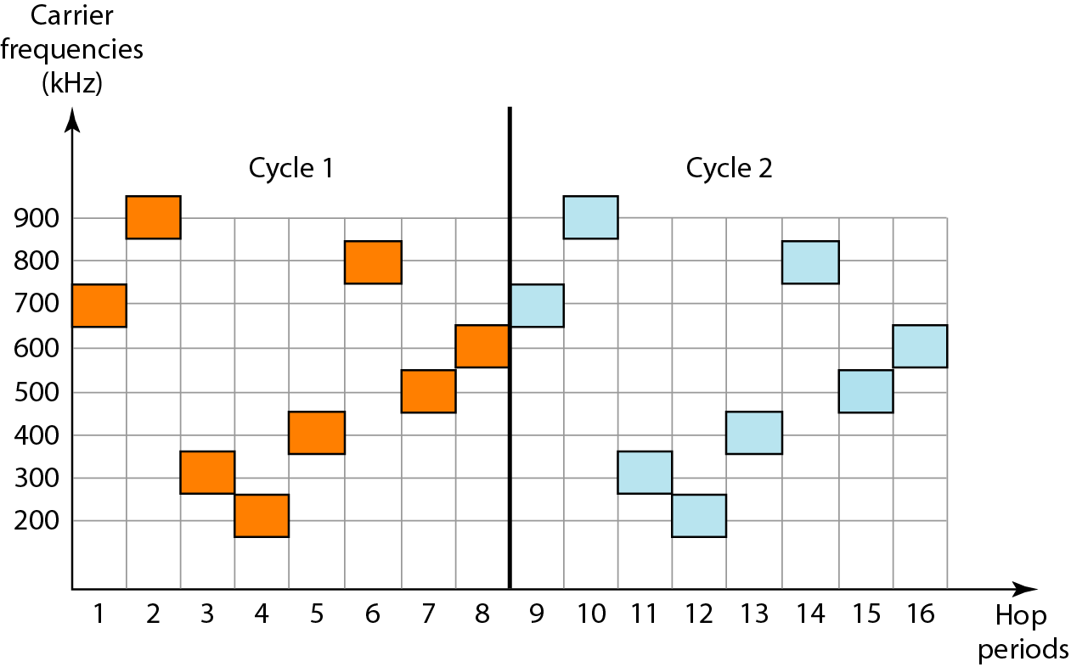
Frequency Cycles

Slide 30
FHSS Performance Considerations
Large number of frequencies used
Results in a system that is quite resistant to jamming
Jammer must jam all frequencies
With fixed power, this reduces the jamming power in any one frequency band

Slide 31
Direct Sequence Spread Spectrum (DSSS
The direct sequence spread spectrum technique also expands the bandwidth of the original signal, but the process is different.
In DSSS, we replace each data bit with n bits using a spreading code. In other words, each bit is assigned a code of n bits, called chips, where the chip rate is n times that of the data

Slide 32
Direct Sequence Spread Spectrum (DSSS)
Each bit in original signal is represented by multiple bits in the transmitted signal
Spreading code spreads signal across a wider frequency band
Spread is in direct proportion to number of bits used
One technique combines digital information stream with the spreading code bit stream using exclusive-OR

Slide 33
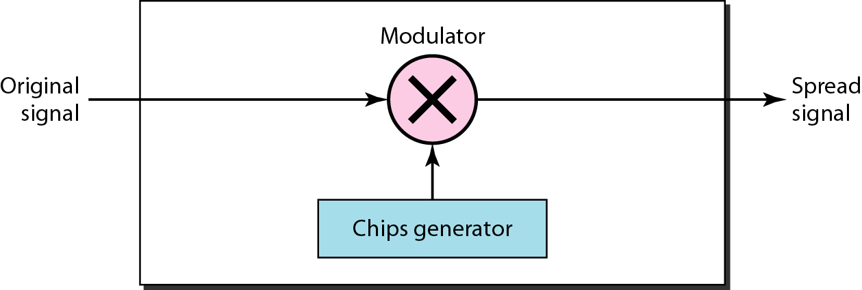
DSSS
Direct Sequence Spread Spectrum (DSSS)
Replace each data bit with n bits using a spreading code
Each bit is assigned a code of n bits called chips

Slide 34
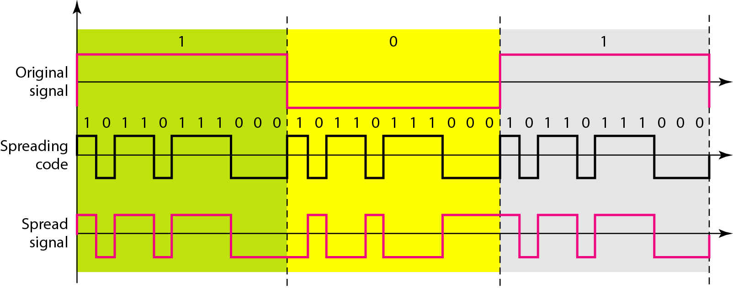
DSSS Example

Slide 35
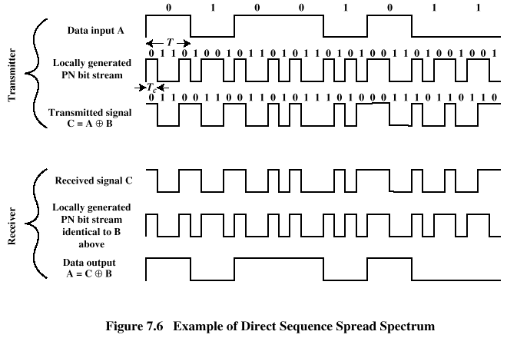
Direct Sequence Spread Spectrum (DSSS)

Slide 36
Demand Assignment Protocols
Polling
Reservation

Slide 37
Polling
A widely used demand assignment scheme
A master control device queries, in some predetermined order, each slave node about whether it has data to transmit.
If the polled node has data to transmit, it informs the controller of its intention to transmit.
In response, the controller allocates the channel to the ready node, which uses the full data rate to transmit its traffic.
If the node being polled has no data to transmit, it declines the controller’s request.
In response, the controller proceeds to query the next network node.

Slide 38
Polling
Disadvantage:
The substantial overhead caused by the large number of messages generated by the controller to query the communicating nodess.
The efficiency of the polling scheme depends on the reliability of the controller.
Advantage:
All nodes can receive equal access to the channel.

Slide 39
Reservation
To set some time slots for carrying reservation messages - minislots.
When a station has data to send, it requests a data slot by sending a reservation message to the master in a reservation minislot.
Packet collisions can happen only when stations contend for the minislot, which use only a small fraction of the total bandwidth. Thus, the largest part of the bandwidth assigned to data packets is used efficiently.

Slide 40
Random Access
Random Access Methods
more efficient way of managing medium access for communicating short bursty messages
in contrast to fixed-access schemes, each user gains access to medium only when needed -has some data to send
drawback: users must compete to access the medium (‘random access’)
collision of contending transmissions
Random Access Methods in Wireless Networks
can be divided into two groups:
ALOHA based-no coordination between users
carrier-sense based-indirect coordination -users sense availability of medium before transmitting

Slide 41
Random Access
Collision Period
User 4
User 3
User 2
rescheduled
User 1
Time

Slide 42
ALOHA-based Random Access
user accesses medium as soon as it has a packet ready to transmit
after transmission, user waits a length of time > round-trip delay in the network, for an ACK from the receiver
if no ACK arrives, user waits a random interval of time (to avoid repeated collision) and retransmits
advantages:
simple, no synchronization among users required
disadvantages:
low throughput under heavy load conditions
probability of collision increases as number of users increases
max throughput = 18% of channel capacity

Slide 43
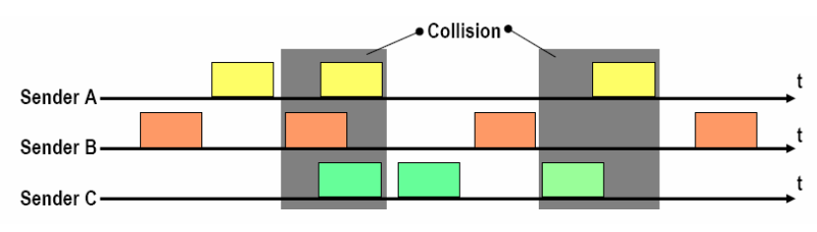
Pure-ALOHA

Slide 44
Slotted ALOHA
time is divided into equal time slots –when a user has a packet to transmit, the packet is buffered and transmitted at the start of the next time slot
BS transmits a beacon signal for timing, all users must synchronize their clocks
advantages:
partial packet collision avoided
Disadvantages
throughput still quite low!
there is either no collision or a complete collision
max throughput = 36% of channel capacity

Slide 45
Slotted ALOHA

Slide 46
Reservation ALOHA
Time slots are divided into reservation and transmission slots / periods
during reservation period, stations can reserve future slots in transmission period
reservation slot size << transmission slot size
collisions occur only in reservation slots
advantages:
higher throughput under heavy loads
max throughput up to 80% of channel capacity
disadvantages:
more demanding on users as they have to obtain / keep ‘reservation list’ up-to-date
R-Aloha is most commonly used in satellite systems
satellite collects requests, complies ‘reservation list’ and finally sends the list back to users

Slide 47
R-ALOHA

Slide 48
Carrier Sense Multiple Access with Collision Detect (CSMA/CD)
With CSMA/CD, when an Ethernet device attempts to access the network to send data, the network interface on the workstation or server checks to see if the network is quiet. When the network is clear, the network interface knows that transmission can begin. If it does not sense a carrier, the interface waits a random amount of time before retrying. If the network is quiet and two devices try sending data at the same time, their signals collide. When this collision is detected, both devices back off and wait a random amount of time before retrying,

Slide 49
CSMA/CD Operation
Carrier sense— Each computer on the LAN is always listening for traffic on the wire to determine when gaps between frame transmissions occur.
Multiple access— Any computer can begin sending data whenever it detects that the network is quiet. (There is no traffic.)
Collision detect— If two or more computers in the same CSMA/CD network collision domain begin sending at the same time, the bit streams from each sending computer interfere, or collide, with each other, making each transmission unreadable. If this collision occurs, each sending computer must be able to detect that a collision has occurred before it has finished sending its frame.
Each computer must stop sending its traffic as soon as it has detected the collision and then wait some random length of time, called the back-off algorithm, before attempting to retransmit the frame.

Slide 50
Carrier Sense Multiple Access (CSMA)
Disadvantages of ALOHA
users do not listen to the channel before (and while) transmitting
suitable for networks with long propagation delays
Carrier Sense Multiple Access
polite version of ALOHA
Listen to the channel before transmitting
if sensed channel busy, back-off (defer transmission), and sense channel again after a random amount of time
if channel idle, transmit entire frame

Slide 51
Versions of CSMA
Employs different node behaviour when channel found busy
non-persistent CSMA
persistent CSMA
1-persistent CSMA
p-persistent CSMA

Slide 52
Persistence Methods
What should a station do if the channel is busy? What should a station do if the channel is idle? 4 methods have been devised to answer these questions: the I-persistent method, the nonpersistent method, and the p-persistent method. Figure shows the behavior of three persistence methods when a station finds a channel busy.
Persistent:- station sense the channel, if channel is ideal it transmits data. if there is already some traffic going on that it does not transmit the data. Keep sensing.

Slide 53
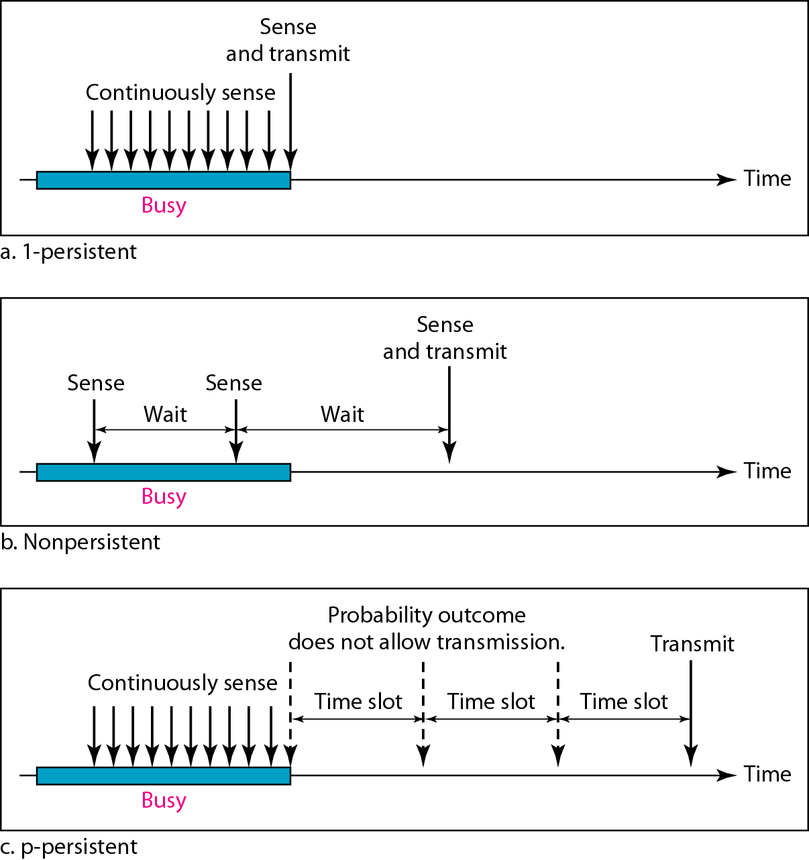
CSMA: Persistence Methods
Behavior of 1-persistent, Nonpersistent, p-persistent method

Slide 54
Persistence Methods
I-Persistent The I-persistent method is simple and straightforward. In this method,after the station finds the line idle, it sends its frame immediately (with probability I).This method has the highest chance of collision because two or more stations may find the line idle and send their frames immediately.
Nonpersistent:- In the nonpersistent method, a station that has a frame to send senses the line. If the line is idle, it sends immediately. If the line is not idle, it waits a random amount of time and then senses the line again. The nonpersistent approach reduces the chance of collision because it is unlikely that two or more stations will wait the same amount of time and retry to send simultaneously. However, this method reduces the efficiency of the network because the medium remains idle when there may be stations with frames to send.

Slide 55
Persistence Methods
p-Persistent :- The p-persistent method is used if the channel has time slots with a slot duration equal to or greater than the maximum propagation time. The p-persistent approach combines the advantages of the other two strategies. It reduces the chance of collision and improves efficiency. In this method, after the station finds the line idle it follows these steps:
1. With probability p, the station sends its frame.
2. With probability q = 1 - p, the station waits for the beginning of the next time slot and checks the line again.
a. If the line is idle, it goes to step 1.
b. If the line is busy, it acts as though a collision has occurred and uses the backoff procedure

Slide 56
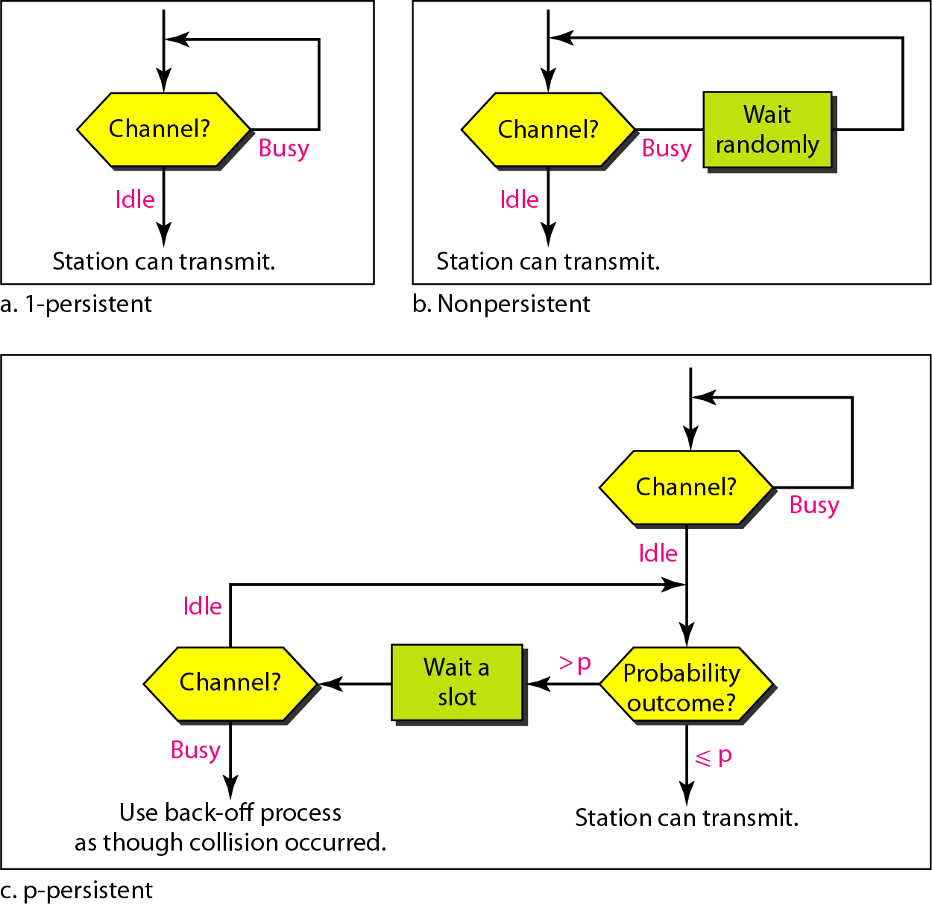
Flow diagram for 1-persistent, Nonpersistent, p-persistent method

Slide 57
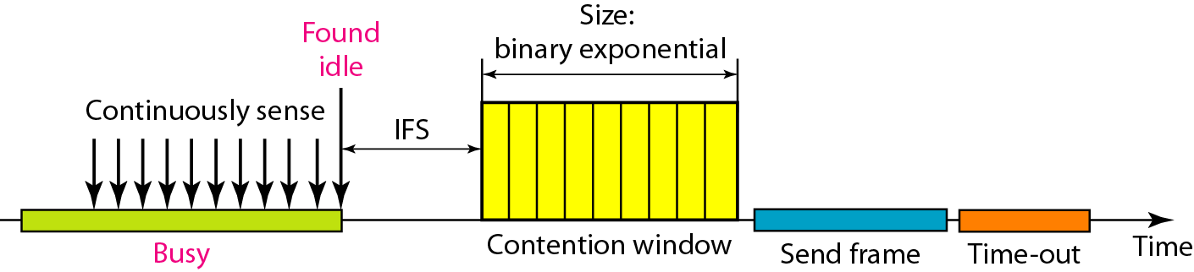
CSMA/CA (Collision Avoidance)
Invented for wireless network where we cannot detect collisions Collision are avoided through the use of CSMA/CA’s three strategies: the interframe space, the contention windows, and acknowledgement
IFS can also be used to define the priority of a station or a frame If the station finds the channel busy, it does not restart the timer of the contention window; it stops the timer and restarts it when the channel becomes idle

Slide 58
CSMA / Collision Avoidance
CSMA/CA is designed to reduce collision probability at points where collisions would most likely occur
when medium has become idle after a busy state, as several users could have been waiting for medium to become available
key elements of CSMA/CA:
IFS –interframe spacing –priority mechanism–the shorter the IFS the higher the priority for transmission
CW intervals –contention window –intervals used for contention and transmission of packet frames
Backoff counter–used only if two or more stations compete for transmission

Slide 59
CSMA/CA Algorithm
Frame to
transmit
Medium
Idle?
No
Wait until
Trans ends
Yes
Wait IFS
Wait IFS
Still
Idle?
No
Still
Idle?
No
If medium becomes busy during the backoff
time, the backoff timer is halted and
resumes when the medium becomes idle.
Yes
Yes
Exp b/o while
Medium idle
Transmit frame
Transmit frame

Slide 60
Example

Slide 61
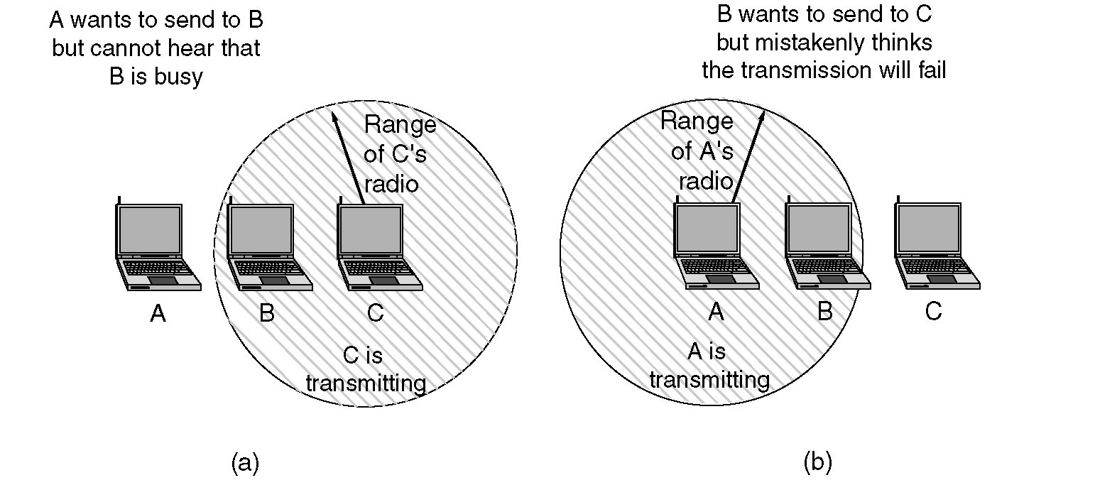
Problems in Wireless Network
The hidden station problem
The exposed station problem.

Slide 62
The Hidden Terminal Problem
Wireless stations have transmission ranges and not all stations are within radio range of each other.
Simple CSMA will not work!
C transmits to B.
If A “senses” the channel, it will not hear C’s transmission and falsely conclude that A can begin a transmission to B.

Slide 63
The Exposed Station Problem
The inverse problem.
B wants to send to C and listens to the channel.
When B hears A’s transmission, B falsely assumes that it cannot send to C.

Slide 64
MACA Protocols
MACA protocol solved hidden, exposed terminal:
Send Ready-to-Send (RTS) and Clear-to-Send (CTS) first
RTS, CTS helps determine who else is in range or busy (Collision avoidance).

Slide 65
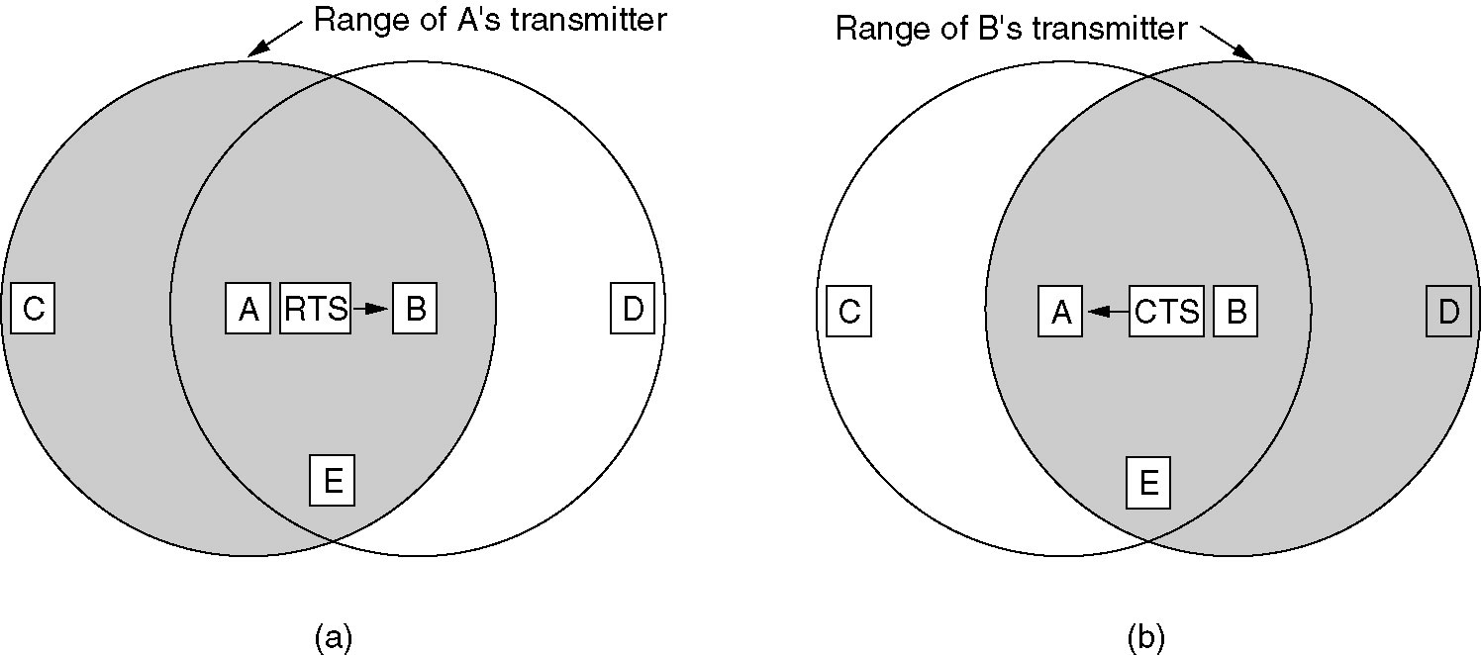

Slide 66
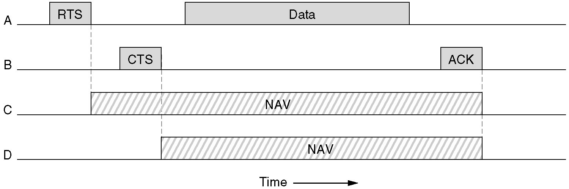
Virtual Channel Sensing in CSMA/CA
The use of virtual channel sensing using CSMA/CA.
C (in range of A) receives the RTS and based on information in RTS creates a virtual channel busy NAV.
D (in range of B) receives the CTS and creates a shorter NAV.

Slide 67
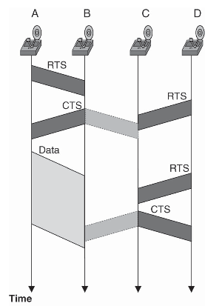
Failure of Collision Avoidance

Slide 68
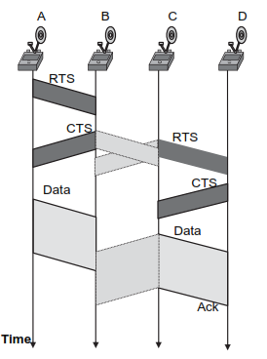
Failure of Collision Avoidance

Slide 69
MAC For WSN
Main Objective
To reduce energy waste caused by
Collision
Idle Listening
Overhearing
Excessive Overhead
Categories of MAC protocols for WSN
Schedule based
Deterministic Protocols
Accesses channels based on schedule – Pre-allocation of resources
Channel access limited to one sensor at a time → No collision
Random-Access based (Contention based)

Slide 70
Schedule based MAC Protocols
Objectives
High level of energy efficiency
Scalability
Adaptability to changes in traffic loads and network topology
Many protocols based on TDMA
Frames – Time slots – Repeats cyclically over time
Each node is assigned a set of specific time slot
Assignment of time slot may be
Fixed schedule
On demand on a per frame basis
Hybrid – varies over different time scale and sensor behavior

Slide 71
Schedule based MAC Protocols
Based on its assigned schedule, a sensor alternates between two modes of operation:
Active mode – Uses the assigned slots to transmit and receive data
Sleep mode – Switch off radio transceivers to conserve energy
Protocols
Self Organizing MAC for Sensornets (SMACS)
Bluetooth
Low-Energy Adaptive Clustering Hierarchy (LEACH)

Slide 72
Self-Organizing Medium Access Control for Sensornets
SMACS is a medium access control protocol to enable the formation of Random Network Topologies without the need to establish global synchronization among the network nodes.
A key feature of SMACS is its use of a hybrid TDMA/FH method referred to as non-synchronous scheduled communication to enable links to be formed and scheduled concurrently throughout the network without the need for costly exchange of global connectivity information or time synchronization.
Each node in the network maintains a TDMA-like frame, referred to as a superframe, for communication with known neighbors.

Slide 73
Self-Organizing Medium Access Control for Sensornets
Superframe
The length of a superframe is fixed.
Furthermore, the superframe is divided into smaller frames.
The size of each frame is not fixed and may vary in time for a single node and also from node to node.
SMACS requires: that
Each node regularly execute a neighborhood discovery procedure to detect neighboring nodes.
Each node establishes a link to each neighbor discovered by assigning a time slot to this link.
The selection of time slots is such that the node talks only to neighbors at each time slot.

Slide 74
Self-Organizing Medium Access Control for Sensornets
However, since a node and its neighbors are not required to transmit at different slot times, the link establishment procedure must ensure that no interference occurs between adjacent links.
This is achieved by randomly assigning a channel, selected from a large number of channels (FDMA), or spreading code (CDMA) to each link.
Using the superframe structure, each node maintains its own time slot schedules with all its neighbors, and nodes are required to tune their radios to the proper frequency channel or CDMA code to achieve communication.

Slide 75
Bluetooth
Bluetooth is an emerging technology whose primary media access control is a centralized TDMA-based protocol.
Bluetooth is designed to replace cables & infrared links used to connect disparate electronic devices such as cell phones, headsets, PDAs, digital cameras, notebook computers, and their peripherals with one universal short-range radio link.

Slide 76
Bluetooth
Bluetooth operates in the 2.45-GHz ISM frequency band.
Its physical layer is based on a pseudorandom frequency-hopping scheme with a hopping frequency of 1.6 kHz and a scheme for hopping sequence allocation.
A set of 79 hop carriers are defined with 1-MHz spacing.
Each hop sequence defines a Bluetooth channel, which can support 1 Mbps.

Slide 77
Bluetooth
Piconet:
A group of devices sharing a common channel is called a piconet.
Each piconet has a master unit which controls access to the channel, and at most seven slave devices as group participants.
Each channel is divided into 625-ms slots.
Each piconet is assigned a unique frequency-hopping pattern determined by the master’s Bluetooth device address (48 bits) and clock.
All slave devices follow their piconet assigned hopping sequence.

Slide 78
Bluetooth
Bluetooth Frame:
A Bluetooth frame, representing one polling epoch, consists of two slots during which a packet can be exchanged between the piconet master and the slave being polled.
The master polls the slave devices continuously for communication.
A slave can communicate in a slot only if the master has addressed it in a previous slot.
Packets can be one, three, or five time slots long and are transmitted in consecutive slots.
A packet can be more than one slot long if the communication is asynchronous.

Slide 79

Bluetooth
Bluetooth Frame: ( Baseband: Packet Header)
AM_ADDR: 3 bits : address of slave in piconet.
TYPE : One of 16 possible packet types
FLOW : Used to stop flow on ACL link.
ARQN : Positive or negative acknowledgement.
SEQN : Inverted for each new transmitted packet.
HEC : Header-error check.
The entire header is protected by 1/3 rate FEC.

Slide 80
Bluetooth
Operational modes:
To reduce energy consumption, Bluetooth specifies four operational modes:
Active,
Sniff,
Hold, and
Park.

Slide 81
Bluetooth
Operational modes:
Active mode:
In this mode, the slave listens for packet transmission from the master.
On receiving a packet, it checks the address and packet length field of the packet header.
If the packet does not contain its own address, the slave sleeps for the duration of the remaining packet transmission.
The intended slave, however, remains active and receives the packet payload in the following reserved slot.

Slide 82
Bluetooth
Operational modes:
Sniff mode:
It is intended to reduce the duty cycle of a slave’s listen activity.
In this mode, the master transmits to the slave only in specified periodic time slots within a predefined sniff time interval.
A slave in sniff mode listens for the master transmissions only during the specified time slots for any possible transmission to it.

Slide 83
Bluetooth
Operational modes:
Hold mode:
In this mode, a slave goes into the sleep mode for a specified amount of time, referred to as the hold time.
When the hold time expires, the slave returns to the active mode.
Park mode:
In this mode, the slave stays in the sleep state for an unspecified amount of time.
The master has to awake the slave explicitly and bring it into the active mode at a future time.

Slide 84
Bluetooth
Types of Communication:
Bluetooth specifies four types of communication between nodes within and across piconets:
Intra piconet unicast, for slave-to-slave communication within a piconet;
Intra piconet broadcast, to support broadcasting by a slave to all participants within its piconet;
Inter piconet unicast, for piconet-to-piconet communications; and
Inter piconet broadcast, for piconet-to-all scatternets node communications.

Slide 85
Bluetooth
Intra piconet unicast:
For intra piconet unicast communication, the source slave writes its own MAC address in the corresponding field of the data packet.
It sets the forward field to 1 and the destination address of the packet to the targeted destination node.
Upon receiving the message, the master checks the forward field.
If it is set, the master replaces the MAC address field with its MAC address and sends the message to the intended slave device indicated by the destination address of the original packet.

Slide 86
Bluetooth
Intra piconet broadcast:
For intra piconet broadcast communication, the source slave:
Writes its own MAC address
Sets the forward field to 1
Set the destination address to 000.
Upon receiving the message, the master:
Notices that the forward field is set or not.
In response, it replaces the MAC address with its own address
Sends the message to all nodes in its piconet.

Slide 87
Bluetooth
Inter piconet unicast:
For inter piconet unicast communication, the source device:
Sends the data packet with its own MAC address
Sets the forward field to 1
Sets the broadcast field to 1
Sets the destination address to the relay of the next piconet.
Furthermore, it sets the routing vector field (RVF) of the packet to contain the logical path to the targeted destination device in the intended piconet.

Slide 88
Bluetooth
RFV
The RVF is a sequence of tuples of the form (LocId, Mac_Addr),
where,
LocId represents the identity of the local master and
Mac_Addr is its corresponding piconet MAC address.
Upon receiving the message, the master:
forwards that message to the relay node.
The relay extracts from the RVF the next pair,
- Containing the local identity and the MAC address of the master, &
- Sends the message to this master.

Slide 89
Bluetooth
Inter piconet broadcast:
For intra piconet broadcast communication, the source device:
Creates a packet containing its own MAC address
Sets the forward & broadcast field to 1
Set the destination address to 000.
Upon receiving the message, the master:
Notices that the broadcast field is set to 1.
It sends the packet to all the slaves within its piconet, including relay nodes.
When a relay node receives the broadcast packet
It forwards it to all masters to which it is connected, except the one from which it came.

Slide 90
Low-Energy Adaptive Clustering Hierarchy
LEACH takes a hierarchical approach & organizes nodes into clusters.
Within each cluster, nodes take turns to assume the role of a cluster head.
LEACH uses TDMA to achieve communication between nodes & their cluster head.
The cluster head forwards messages to the base station which received from its cluster nodes.

Slide 91
Low-Energy Adaptive Clustering Hierarchy
The cluster head node sets up a TDMA schedule & transmits this schedule to all nodes in its cluster.
The schedule prevents collisions among data messages.
Furthermore, the schedule can be used by the nodes to determine the time slots during which they must be active.
This allows each cluster node, except for the head cluster, to turn off their radio components until its allocated time slots.
LEACH assumes that cluster nodes start the cluster setup phase at the same time and remain synchronized thereafter.
One possible mechanism to achieve synchronization is to have the base station send out synchronization pulses to the all the nodes.

Slide 92
Low-Energy Adaptive Clustering Hierarchy
To reduce intercluster interference, LEACH uses a transmitter-based code assignment scheme.
Communications between a node and its cluster head are achieved using direct-sequence spread spectrum (DSSS), whereby each cluster is assigned a unique spreading code, which is used by all nodes in the cluster to transmit their data to the cluster head.
Spreading codes are assigned to cluster heads on a first-in, first-served basis, starting with the first cluster head to announce its position, followed by subsequent cluster heads.
Nodes are also required to adjust their transmit powers to reduce interference with nearby clusters.

Slide 93
Low-Energy Adaptive Clustering Hierarchy
Upon receiving data packets from its cluster nodes, the cluster head aggregates the data before sending them to the base station.
The communication between a cluster head and a base station is achieved using fixed spreading code and CSMA.
Before transmitting data to the base station, the cluster head must sense the channel to ensure that no other cluster head is currently transmitting data using the base station spreading code.
If the channel is sensed busy, the cluster head delays the data transmission until the channel becomes idle.
When this event occurs, the cluster head sends the data using the base station spreading code.

Slide 94
Advantages of Schedule-based Protocol
Schedule-based protocols are contention-free, and as such, they eliminate energy waste caused by collisions.
Sensor nodes need only turn their radios on during those slots where data are to be transmitted or received.
In all other slots, the sensor node can turn off its radio, thereby avoiding overhearing.
This results in low-duty-cycle node operations, which may extend the network lifetime significantly.

Slide 95
Disadvantages of Schedule-based Protocol
The use of TDMA requires the organization of nodes into clusters.
This hierarchical structure often restricts nodes to communicate only with their cluster head.
Peer-to-Peer communication cannot be supported directly, unless nodes are required to listen during all time slots.
Most of the schedule-based schemes depend on distributed, fine-grained time synchronization to align slot boundaries.
Achieving time synchronization among distributed sensor nodes is difficult and costly.

Slide 96
Disadvantages of Schedule-based Protocol
Schedule-based schemes also require additional mechanisms such as FDMA or CDMA to overcome intercluster communications and interference.
Finally, TDMA-based MAC-layer protocols have limited scalability and are not easily adaptable to node mobility and changes in network traffic & topology.
As nodes join or leave a cluster, the frame length as well as the slot assignment must be adjusted.
Frequent changes may be expensive or slow to take effect.

Slide 97
Random Access-Based Protocols
-contention-based protocols

Slide 98
Random Access based MAC Protocols
Power aware Multi Access protocol with signaling (PAMAS)
Sparse Topology and Energy Management (STEM)
Time-out MAC (T-MAC)
Berkely Media Access Control (B-MAC)

Slide 99
Random Access-Based Protocols
require no coordination among the nodes accessing the channel.
Colliding nodes back off for a random duration of time before again attempting to access the channel.
These protocols are not well suited for WSN environments.
The enhancement of these protocols with collision avoidance and request-to-send (RTS) and clear-to-send (CTS) mechanisms improves their performance and makes them more robust to the hidden terminal problem.

Slide 100
Random Access-Based Protocols
Problem:
The energy efficiency of contention-based MAC-layer protocols, however, remains low due to collisions, idle listening, overhearing, and excessive control overhead.
Solution:
To address this shortcoming, efforts in the design of random access MAC-layer protocols focused on reducing energy waste in order to extend the network lifetime.

Slide 101
Power Aware Multi Access protocol with Signalling
PAMAS avoids overhearing among neighbouring nodes by using a separate signalling channel.
combines the use of a busy tone with RTS and CTS packets to allow nodes currently not actively transmitting or receiving packets to turn off their radio transceivers.
The protocol does not, provide mechanisms to reduce energy waste caused by idle listening.

Slide 102
Sparse Topology & Energy Management Protocol
The sparse topology and energy management (STEM) protocol trades latency for energy efficiency.
This is achieved using two radio channels:
Data radio channel & Wake-up radio channel.
A variant of STEM uses a busy tone instead of encoded data for the wake-up signal.
STEM is known as a Pseudoasynchronous Scheduled Scheme.
Based on this scheme, a node turns off its data radio channel until communication with another node is desired.

Slide 103
Sparse Topology & Energy Management Protocol
Mode of operation:
When a node has data to transmit, it begins transmitting on the wake-up radio channel.
The wake-up signal channel acts like a paging signal.
The transmission of this signal lasts long enough to ensure that all neighbouring nodes are paged.
When a node is awakened from its sleeping mode, it may remain awake long enough to receive a ‘‘session’’ of packets.
A node can also be awakened to receive all of its pending packets before going into the sleep mode again.

Slide 104
Sparse Topology & Energy Management Protocol
The STEM protocol is general and can be used in conjunction with other MAC-layer scheduling protocols.
The scheme is effective only in network environments where events do not happen very frequently.
If events occur frequently, the energy wasted by continuously transmitting wake-up signals may offset, or may exceed, the energy gained in sleeping modes.

Slide 105
IEEE 802.11-inspired contention-based protocols
A variety of IEEE 802.11-inspired contention-based protocols prevent overhearing by using RTS and CTS packets.
A common feature of these protocols is to use the overhearing of RTS and CTS packet exchange between two other contending nodes to force a contending node to go into sleep mode.
These protocols also rely on synchronized schedules between neighbouring nodes to avoid idle listening.

Slide 106
IEEE 802.11-inspired contention-based protocols
How they differ?
These protocols differ in the way they maintain low duty cycles and the way they achieve energy efficiency, especially when the size of the data packets is of the same order of magnitude as the size of the RTS and CTS packets.
They also differ in the mechanisms used to reduce packet latency, as a sending node may have to wait a significant period of time before the receiver wakes up.
Finally, the protocols also differ in the level and the way in which they achieve fairness among nodes.

Slide 107
Timeout-MAC
Designed for applications characterized by low message rate and low sensitivity to latency.
To avoid collision and ensure reliable transmission, T-MAC nodes use RTS, CTS, and acknowledgment packets to communicate with each other.
Uses an adaptive duty cycle to reduce energy consumption and adapt to traffic load variations.

Slide 108
Timeout-MAC
The basic idea of the T-MAC protocol is to reduce idle listening by transmitting all messages in bursts of variable length.
Nodes are allowed to sleep between bursts. The protocol dynamically determines the optimal length of the active time, based on current load.
Since messages between active times must be buffered, the buffer capacity determines an upper bound on the maximum frame time.

Slide 109
Berkeley Media Access Control (B-MAC)
Lower-power carrier-sense media access protocol for WSNs
Uses clear channel assessment (CCA) and packet back-offs for channel arbitration, link-layer acknowledgments for reliability, and listening for low-power communication.
No direct support for
hidden terminal problem
message fragmentation,
Enforcing a particular low-power policy.

Slide 110
B-MAC
Provides a set of interfaces for services to tune its operation
Makes local policy decisions to optimize power consumption, latency, throughput, fairness, or reliability.
To achieve low-power operation, B-MAC employs an adaptive preamble sampling scheme to reduce duty cycle and minimize idle listening.
Each time the node wakes up, it turns on the radio and checks for activity.
If it detects activity, the node powers its radio transceiver up and stays awake for the time required to receive the incoming packet. After reception, the node returns to sleep.
If no packet is received within the speciﬁed timeout, the node goes to sleep.
Supports on the-ﬂy reconﬁguration and provides bidirectional interfaces for system services to optimize performance, whether it is for throughput, latency, or power conservation.

